Slide 1



J1-879 M: Optimization in Energy Networks
Special Topics in Systems and Control
Lecture 3
Dr. Yinliang Xu
SYSU-CMU Joint Institute of Engineering, Sun Yat-sen University
SYSU-CMU Shunde International Joint Research Institute

Slide 2
Today’s Lecture
Inequality Constrained Optimization
Linear Optimization Problem

Slide 3
Learning Objective
After this lecture, you should be able to
  formulate the KKT conditions for an inequality and equality constrained optimization problem
  give and explain the dependency between the value of the Lagrange Multipliers for inequality constraints and the constraints being binding or non-binding
  use the Simplex algorithm to solve a linear optimization problem
  describe in three sentences the ideas behind the Simplex algorithm, i.e. how and why it works

Slide 4

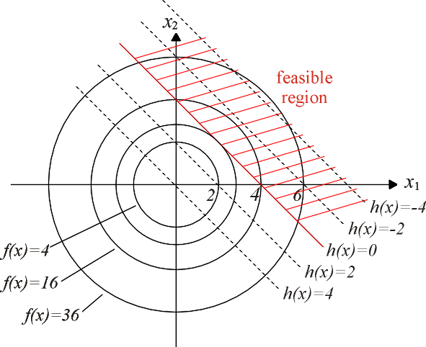
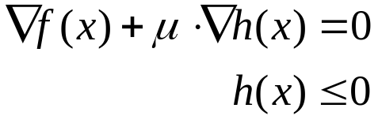



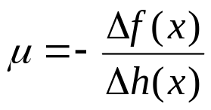
Inequality Constrained Optimization
Constraint binding, i.e.
  Lagrange Multiplier
  Sensitivity:
  gradients of objective function and of constraint are always in opposite directions in optimal point,

Slide 5

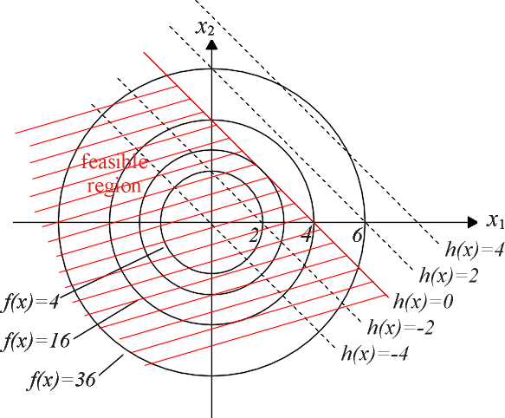


Inequality Constrained Optimization
Constraint non-binding, i.e.
  Lagrange Multiplier
  gradient of objective function is zero, i.e.
Lagrange multiplier is either greater than zero (binding) or equal to zero (non-binding)

Slide 6

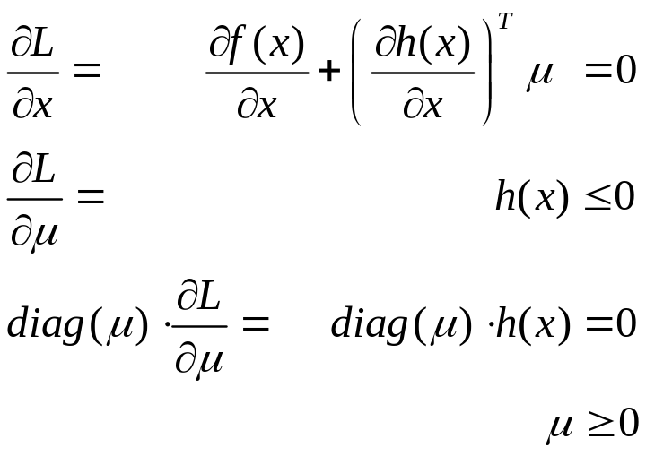
Constrained Optimization
Lagrange Function
Minimize Lagrange Function
Karush-Kuhn-Tucker first order or necessary optimality
conditions for inequality constrained optimization
Solution could be found by checking combinations of binding and non-binding constraints => use solution algorithms

Slide 7
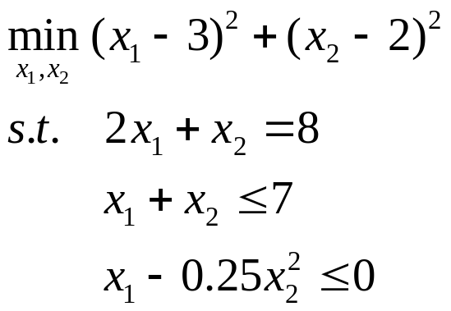
Constrained Optimization
Example:
Write down the KKT conditions for this problem.

Slide 8
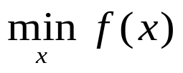
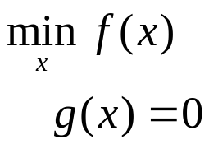
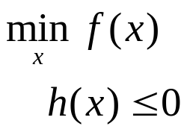
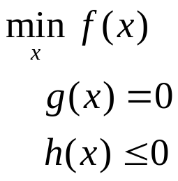
Mathematical Formulation
Unconstrained Optimization:
Equality Constrained Optimization:
Inequality Constrained Optimization:
General Constrained Optimization:

Slide 9
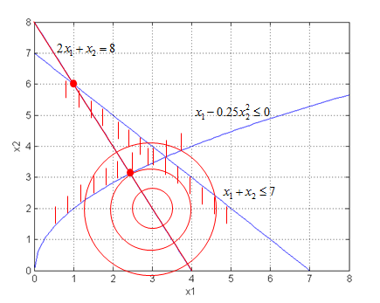
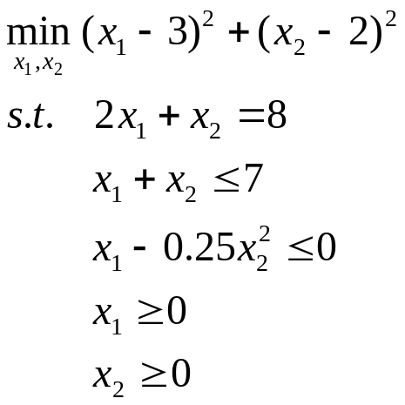
Graphical Optimization
Suitable if only two variables
Example:

Slide 10
Graphical Optimization
Suitable if only two variables
Example:

Slide 11
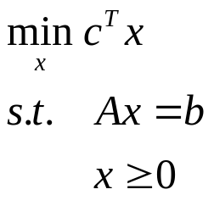


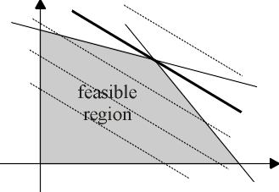




Linear Optimization
General Problem
objective function and constraints are linear functions, i.e. it holds

Slide 12
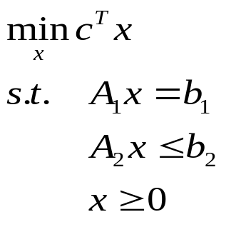
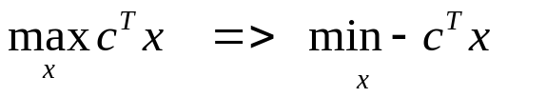
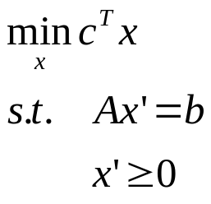
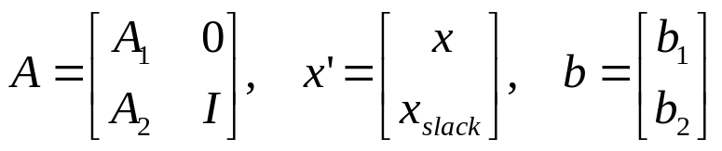
Linear Optimization
General Problem
=> introduce slack variables to convert inequality constraints to
equality constraints
if it is a maximization problem, transform into minimization problem by using

Slide 13


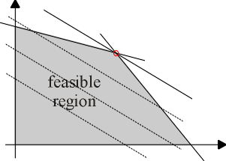
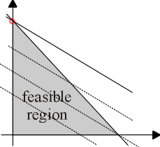
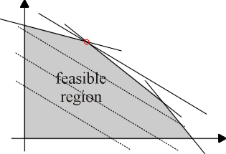


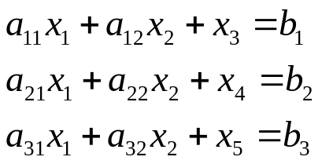

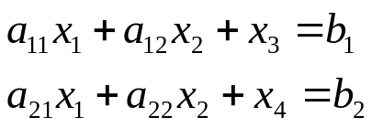
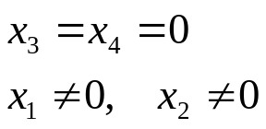
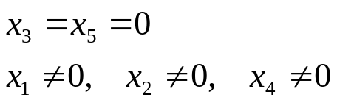

Simplex Solution Algorithm
Dimension of
  => dimension of is equal to dimension of b

Slide 14
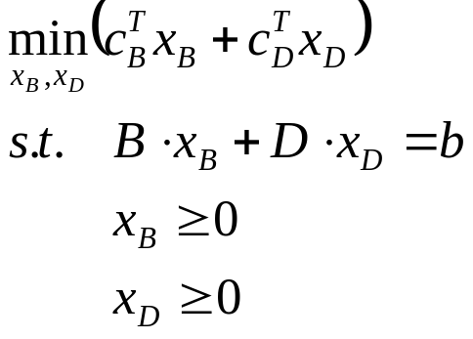
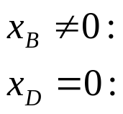
Simplex Solution Algorithm
Splitting into subsets
  basic solution
  non-basic solution

Slide 15
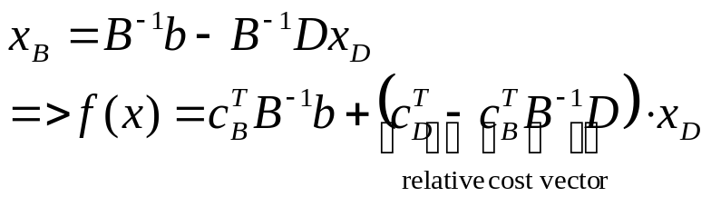
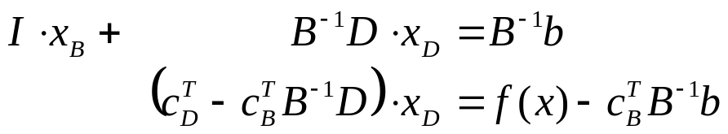
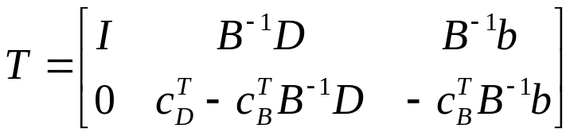
Simplex Solution Algorithm
Standard Tableau
=> standard tableau

Slide 16



Simplex Solution Algorithm
Rotations
  jumping from one corner to a more optimal one => exchanging one variable in with one variable in
  as long as there is a negative value in the relative cost vector, the solution is suboptimal => carry out rotation:
    choose an for which the corresponding entry in the relative cost vector is negative, preferably the most negative one
    choose the for which the entry in the base vector divided by the corresponding coefficient of is greater than zero but as small as possible
unity matrix for x_{B} | coefficients for x_{D} | base vector, i.e. values of x_{B}
 | relative cost vector | -f(x)

Slide 17
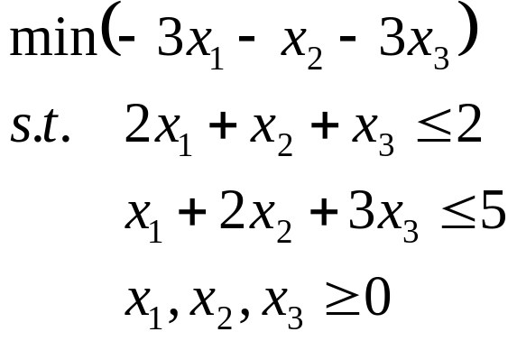
Simplex Solution Algorithm
Example

Slide 18
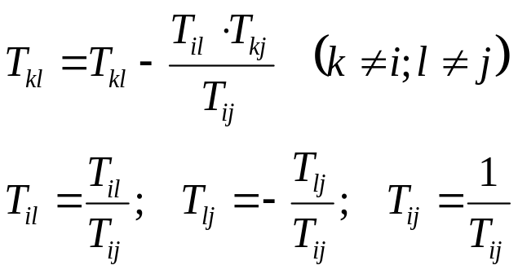
Simplex Solution Algorithm
Find a feasible base point and update the tableau accordingly
Choose the column j which has the most negative cost coefficient in the relative cost vector.
Choose the row i with the smallest positive ratio of the corresponding entry in the base vector and the coefficient T_{ij}
Execute the base change as follows:
If all coefficients in the relative cost vector are positive, the optimal point is found. Else go back to step 2.

Slide 19
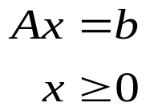
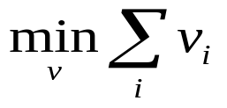
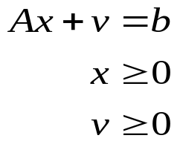
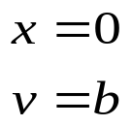


Simplex Solution Algorithm
Finding an initial feasible point => find a solution to
=> carry out Simplex method for secondary problem
=> optimum of this problem is equal to a feasible starting point for the actual problem
Situation in which this might be necessary:
Inequality constraint :
=> add slack variable with negative sign
=> initial point with slack variables as basic variables is not a feasible point, i.e. initial point has to be determined first
Trivial initial solution
for secondary problem:

Slide 20
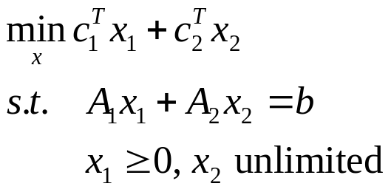
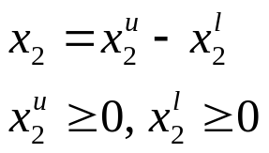
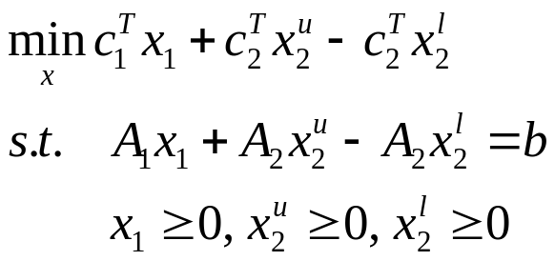
Simplex Solution Algorithm
Unlimited variables
=> replace unlimited variables with two limited variables, i.e.

Slide 21
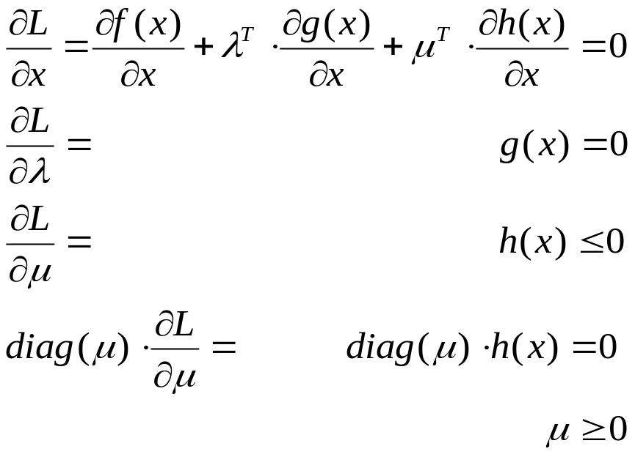
Summary
KKT-conditions
Simplex Algorithm

Slide 22
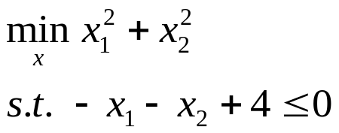
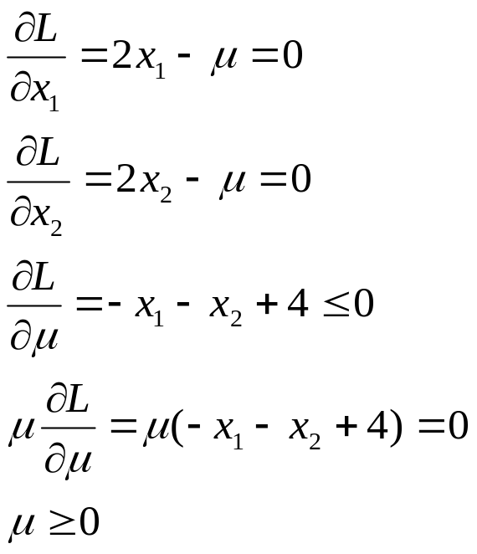
Inequality Constrained Optimization
Example:
Lagrange function:
KKT conditions:

Slide 23
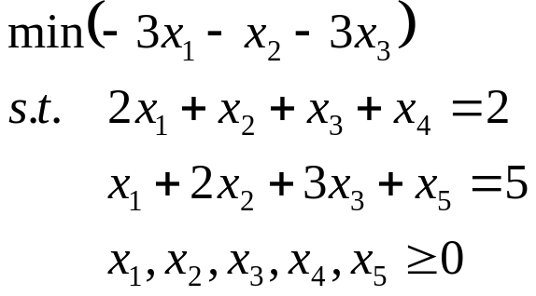
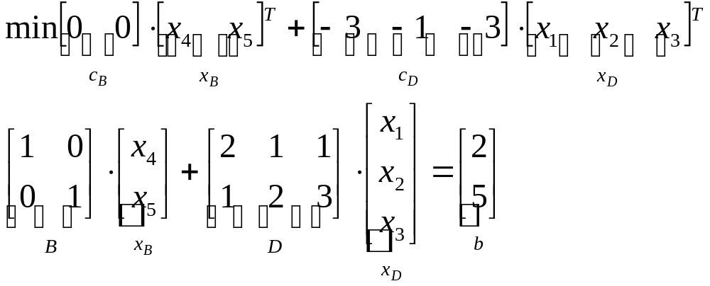
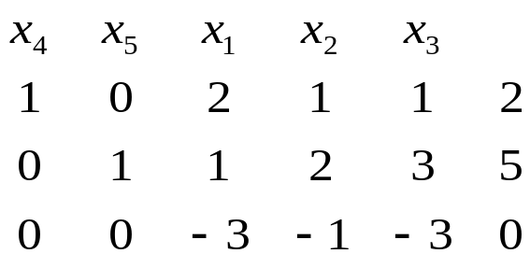
Simplex Solution Algorithm
Example
(0,0,0,2,5) is a solution to this problem => use this as initial solution

Slide 24
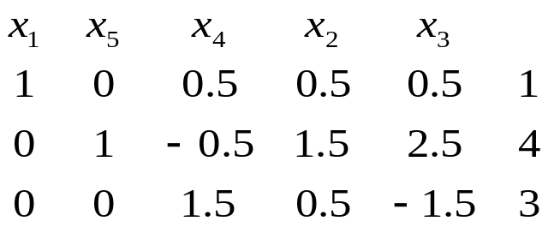
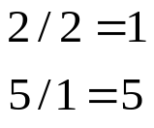
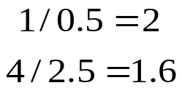
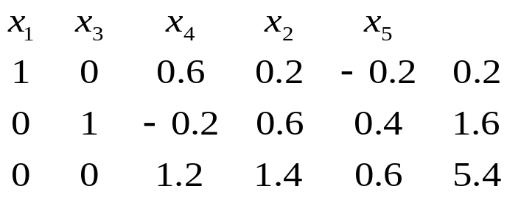
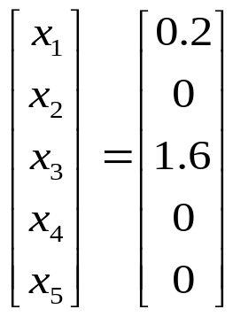

Simplex Solution Algorithm
Example
Solution:
Corner points:

